Slide 1
Bookstore Maintenance
Screenshots

Slide 2
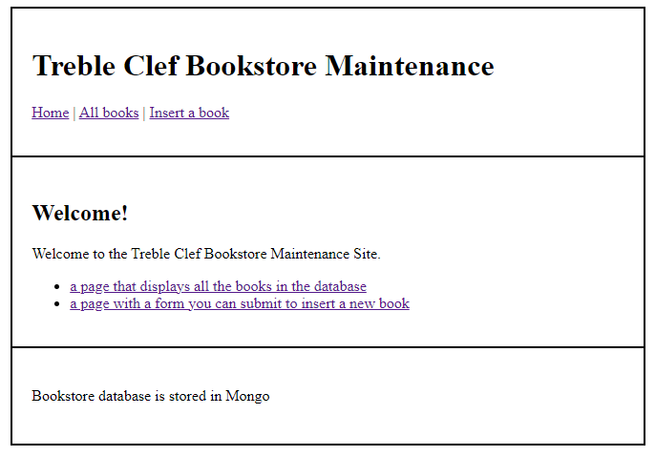
Home Page
Put in your own header, welcome text and footer. The Home link will take user to this page. All books will link to Read Page. Insert a book will link to Insert page.

Slide 3
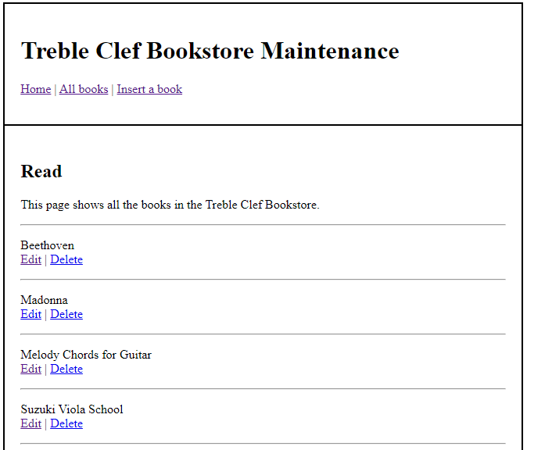
Read Page
Clicking Edit takes user to Edit Page. Clicking Delete refreshes Read Page

Slide 4
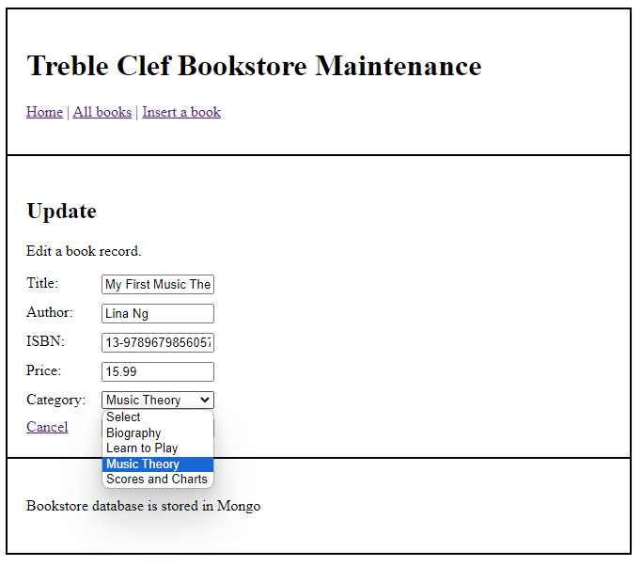
Edit Page
Form fields should be populated with current database data. The dropdown list of categories comes from the category collection in the DB. The current category should be selected. Clicking either update or cancel will redirect to the read page. Updated data should be sent using POST method

Slide 5
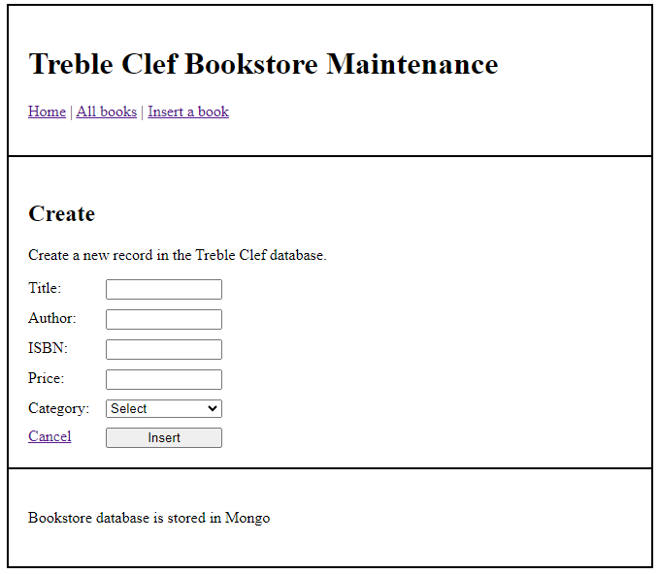
Insert Page
The dropdown list of categories comes from the category collection in the DB. Clicking either insert or cancel will redirect to the read page. Form data should be sent using POST method

